Slide 1

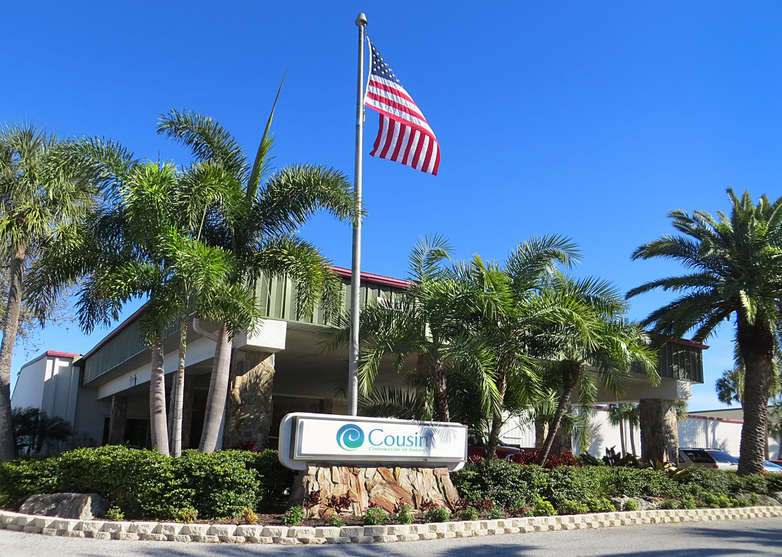

Cousin Corporation of America 12333 Enterprise Blvd. Largo, FL 33773 ph: 727-536-3568 www.cousin.com

Slide 2



Slide 3
OUR GOAL
Our goal each day is to make a positive difference in the
lives of each other, our retailers, our vendors, and our
business partners.

Slide 4
OUR History
Cousin has been family-owned for over 47 years. It all began in 1970 as Enterprise Art, a retail craft store in Largo, Florida. With the success of the arts and crafts, floral and home decor products, a wholesale division was created and Cousin was born. The popularity of jewelry making inspired us to focus our efforts on products for this exciting craft. With the addition of our fashion accessory division Laura Janelle, today we are a premier wholesaler of jewelry making supplies and a full service fashion company.

Slide 5
OUR Mantra
Our Mantra is "Be Mindful". We strive each day to live in the present moment. To be mindful. To be right here, right now. As we increase our awareness through mindfulness, our quality of thought and action grows significantly. This provides us the ability to reach our potential.

Slide 6
OUR Products
Whether it's findings, accents or tools from our Cousin DIY division or trendy jewelry and fashion accessories from our Laura Janelle division, our products are developed from the direct result of extensive trend research and data intelligence. From publications to paid trend resources to fashion trade shows to the runways we are constantly gathering and analyzing data from around the world to make sure we are "on trend" all the time. We feel extremely fortunate to have an amazing group of people on our creative team. Their energy and passion for fashion is contagious!

Slide 7
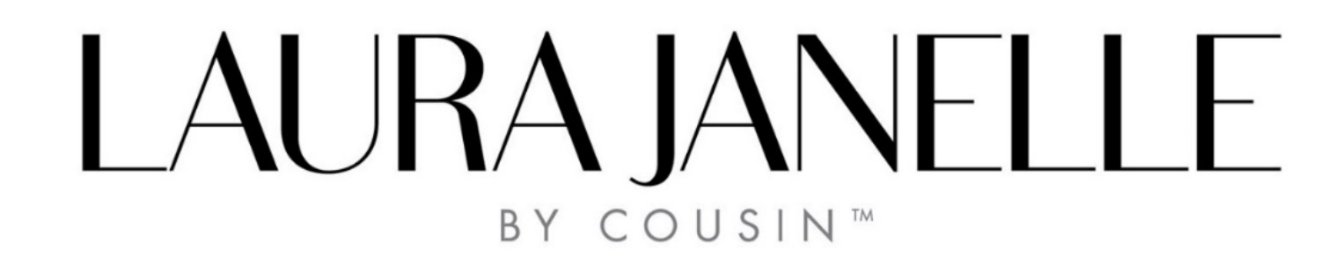

OUR Brands

Slide 8


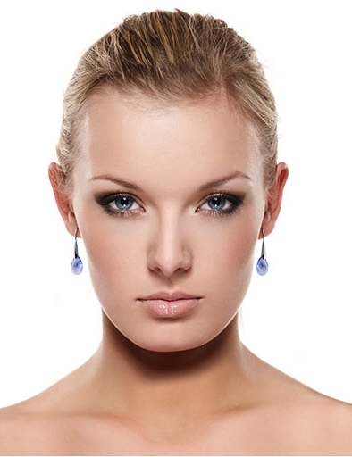
Fashion Accessories for the Gift Market.
Laura Janelle is the wholesale fashion accessory division of Cousin Corporation of America. We push ourselves to the fashion limit to make sure we are bringing you "on trend" products at outstanding value.
From publications to paid trend resources to fashion trade shows to the runways we are constantly gathering and analyzing data from around the world to make sure we are "on trend" all the time. As a full service fashion company, we go from concept to design to packaging; all in house. We feel extremely fortunate to have an amazing group of people on our creative team. Their energy and passion for fashion is contagious!

Slide 9

“Several new brand launches attracted attention at this summer's Dallas Market. Floor|9, a new gift and home brand focused on keeping things young and fresh, made a splash; Cousin Corporation, a DIY fashion jewelry component company, launched Laura Janelle, a new multi-media jewelry and fashion accessories brand”
“Aug 1, 2016 - Floor 9 and Laura Janelle are new brand launches for summer and are debuting for the first time at Las Vegas Market. Gifts and Decorative Accessories' Diane Falvey and Tina Benitez Eves ask about the timing of these brand launches and the excitement they're seeing at Market!”
*Video coverage of Las Vegas Market 2016
GDA Staff, July 18, 2016
*Summer Dallas Market Celebrates New, Unique
Lauren Davidson, Diane Falvey, June 30, 2016
https://www.youtube.com/watch?v=kEIBJEroglI

Slide 10
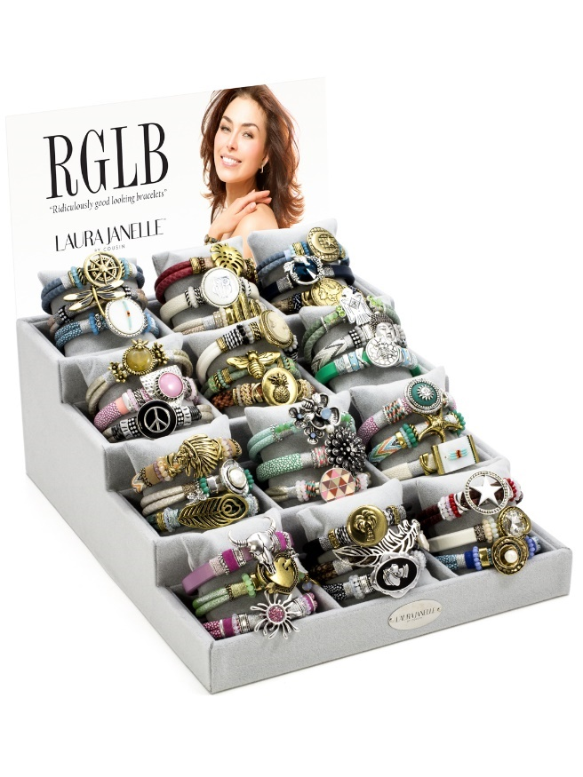
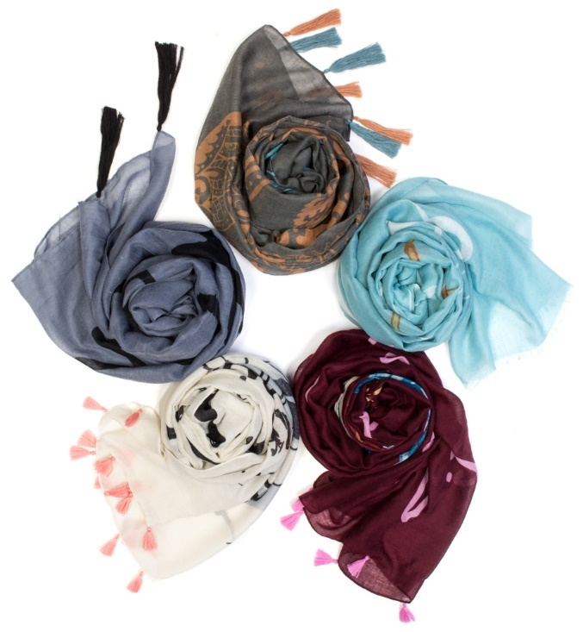
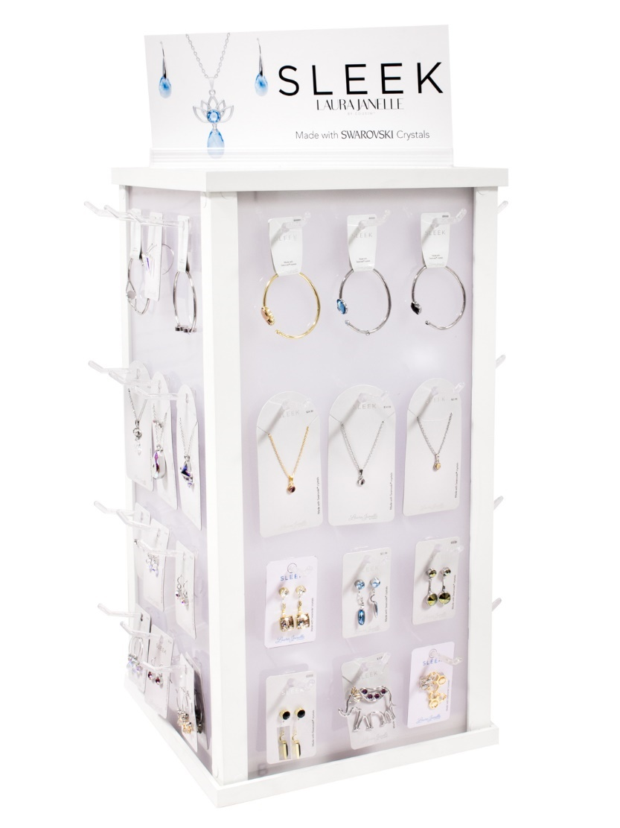
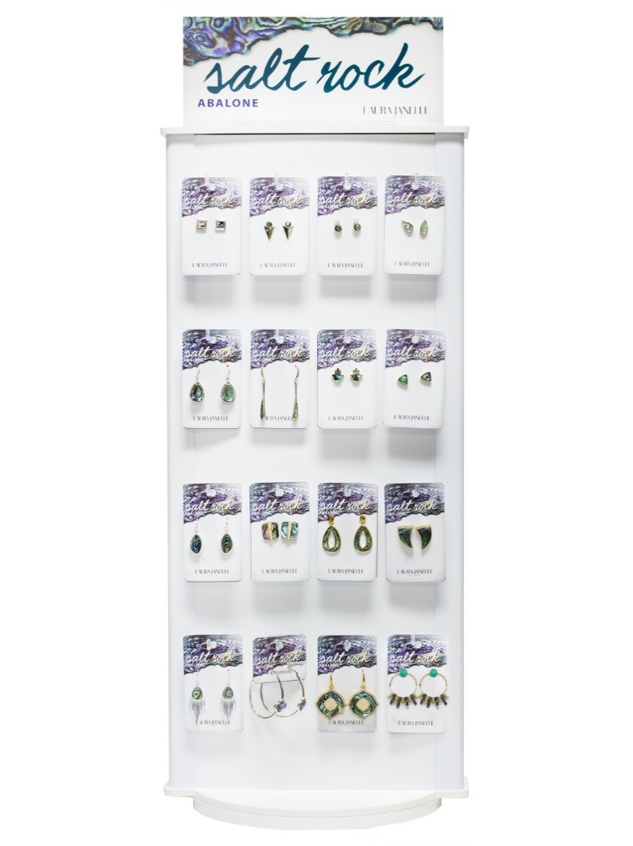
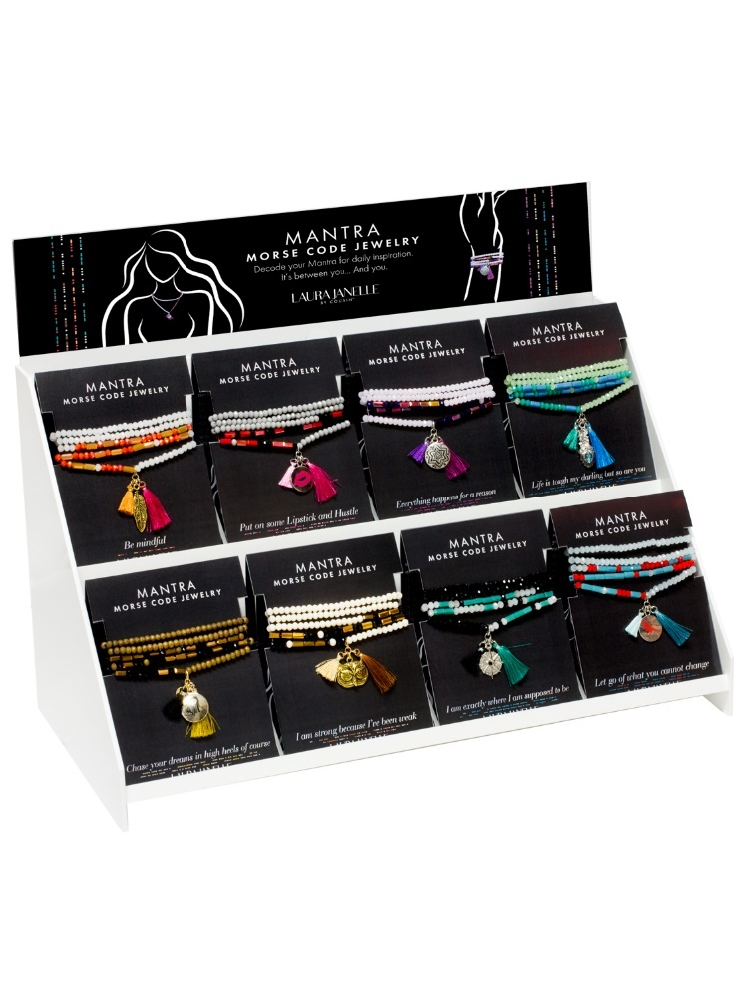
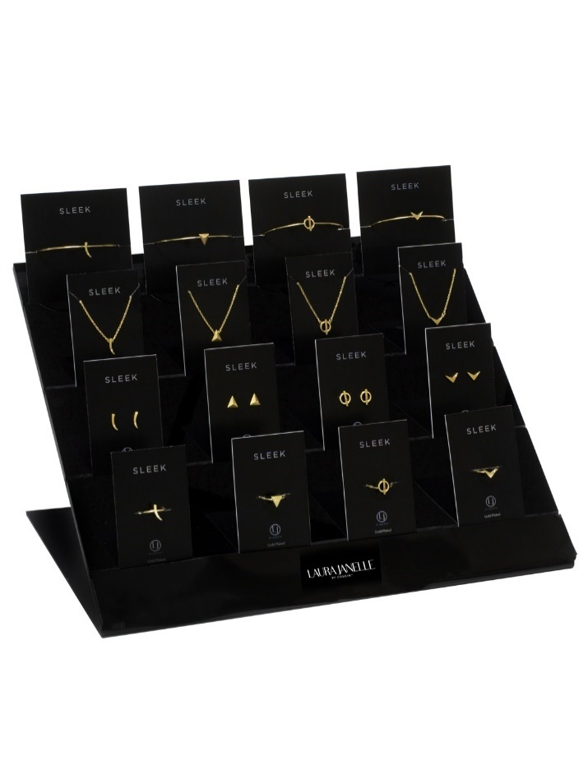

Slide 11






Jewelry Making Supplies for the DIY Market.
Cousin D.I.Y. is the wholesale jewelry making supplies and accessories division of Cousin Corporation of America. The company was founded in 1970 as a craft and art supply store. As the craft industry evolved we evolved with it and became a major player in the jewelry making business.
Today we provide high-quality jewelry making supplies for the beginner and the professional jewelry maker. Our products can be found in major retailers including Walmart, Walmart Canada, Michaels Stores, Jo-Ann Fabric and Craft Stores, Hobby Lobby, A.C. Moore Arts and Crafts, and Meijer.

Slide 12


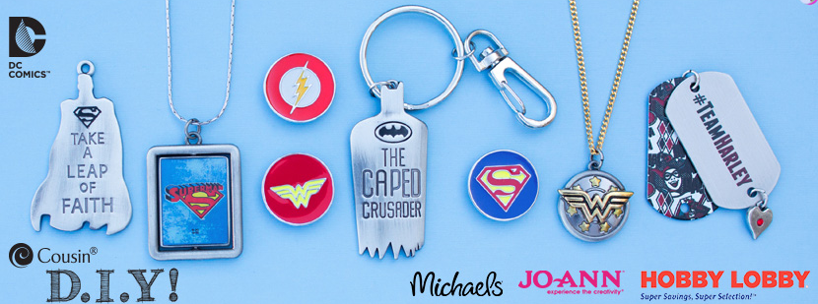
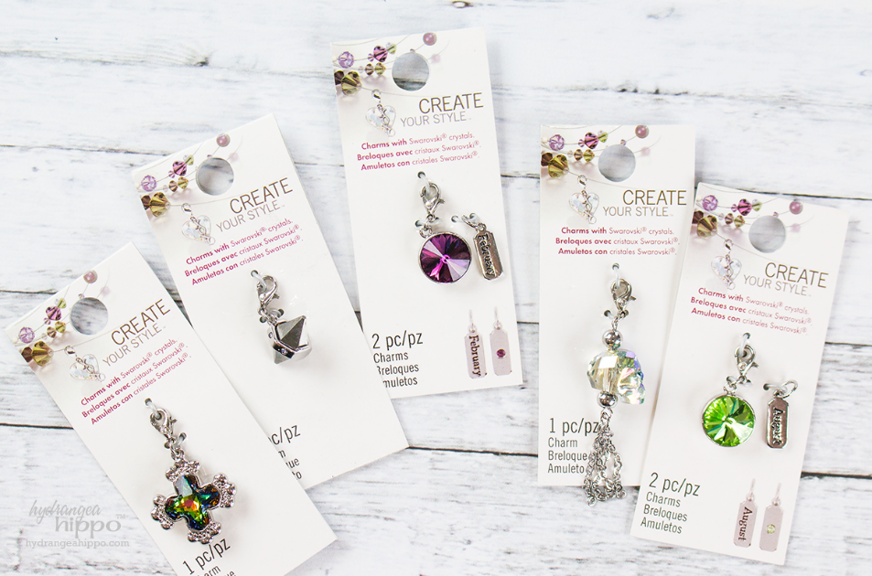

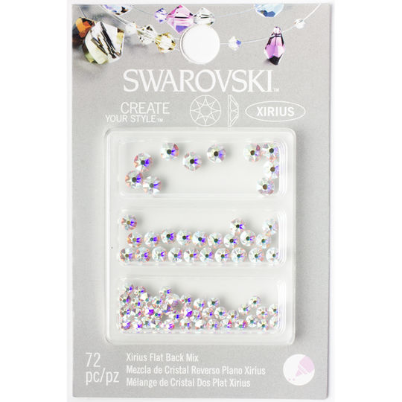
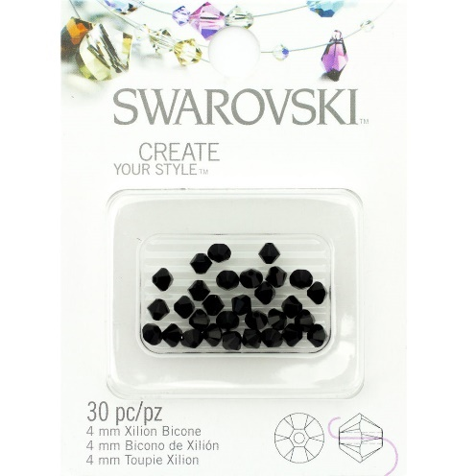
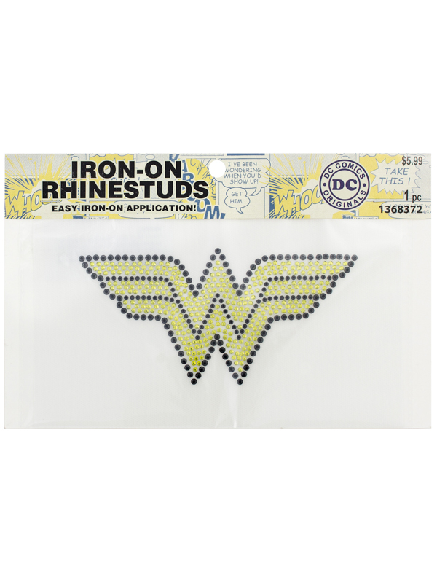

Slide 13

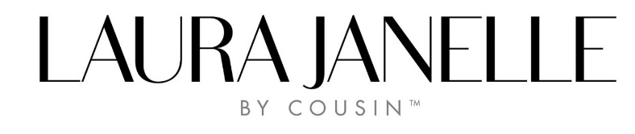
OUR Marketing
We support our products and promote our brand by being innovative. From our interactive website, to our social media campaigns, we are engaged with the fashion community. We are the market leader in fashion accessories.
From showcasing projects on Pinterest to step-by-step tutorials on You Tube, we make sure to provide all information necessary in creating a user-friendly environment. Through the means of education, inspiration, and an ever-growing library of projects, our social media efforts hit all facets of the jewelry-making community.

Slide 14










OUR Social Media
https://www.facebook.com/CousinCorp/
https://www.facebook.com/laurajanellebycousin/
https://www.facebook.com/CousinDIY/
https://twitter.com/CousinCorp
https://twitter.com/LJbyCousin
https://twitter.com/CousinDIY
https://www.pinterest.com/cousinpinterest/
https://www.pinterest.com/laurajbycousin/
https://www.pinterest.com/CousinDIY/
https://www.instagram.com/cousincorp/
https://www.instagram.com/laurajanellebycousin/
https://www.youtube.com/user/CousinCorporation
https://www.youtube.com/user/CousinCorporation
https://www.linkedin.com/company/laura-janelle
https://www.linkedin.com/company/cousin-corporation-of-america

Slide 15
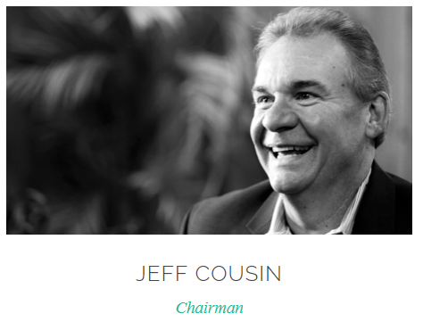
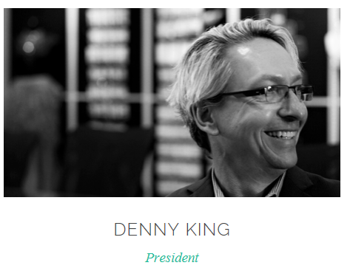
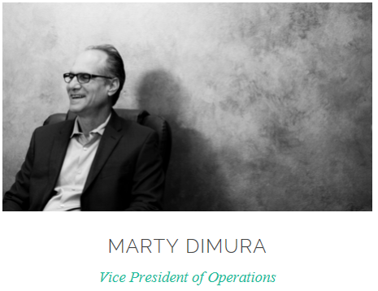
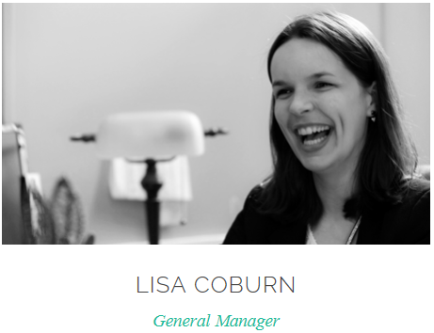
OUR Team
SENIOR LEADERSHIP

Slide 16
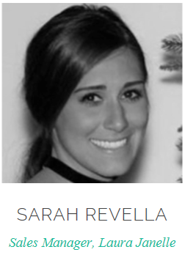
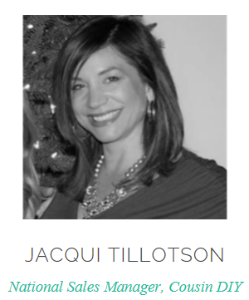
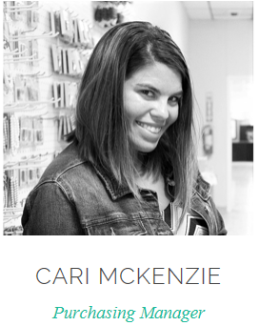
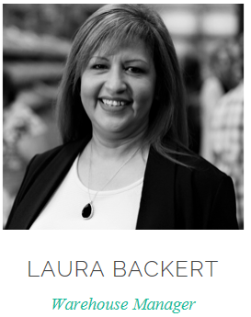
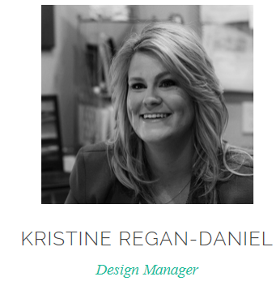
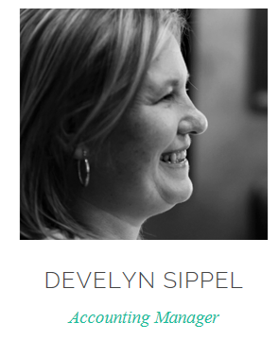
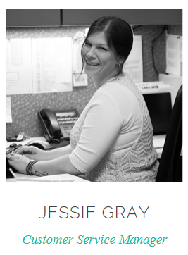
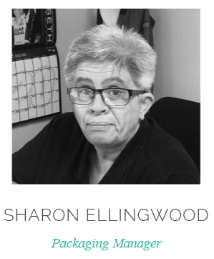
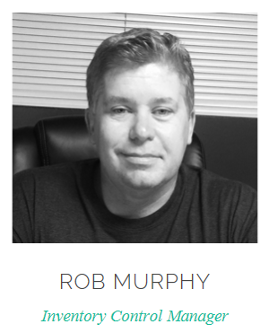
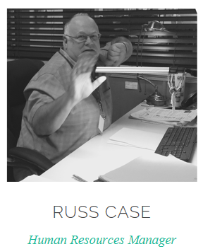
OUR Team
Management Team

Slide 18
Thank you!

